Slide 1
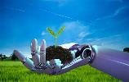
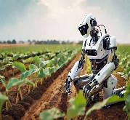
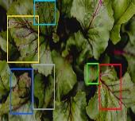
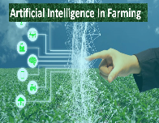
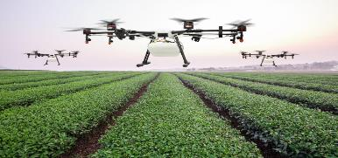
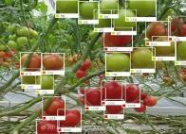
Generative AI Cultivation: Innovations and Insights in Agricultural Disease Management
G.LIKITHA
K.SAiLATHA

Slide 2
CONTEXT
Introduction
How generative AI is used in Agriculture
Challenges in Agriculture & Plant Diseases
AI based solutions
Advancement in plant diseases detection
Case study
Conclusion

Slide 3
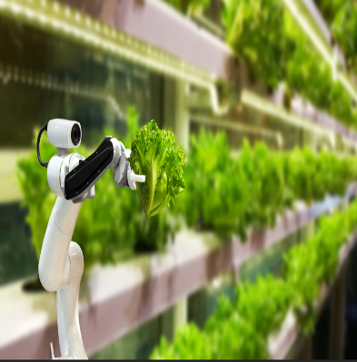
Introduction
Agricultural diseases pose a significant threat to global food security, leading to substantial yield losses and economic instability.
Traditional disease management methods are often reactive, resource-intensive, and sometimes ineffective.
AI technologies, such as machine learning and deep learning, are being applied to solve complex agricultural challenges.
Factors such as climate change, globalization, and evolving pathogens contribute to the complexity of disease management.
Generative AI is being increasingly utilized in agriculture to address various challenges, including disease management.

Slide 4
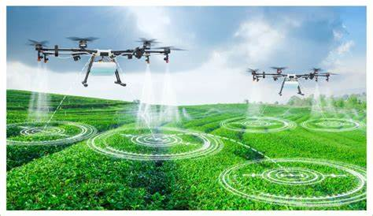
How Generative AI is used in Agriculture
Generative AI models can analyze various data sources such as weather patterns, soil quality, historical yield data, and satellite imagery to predict crop yields. These predictions help farmers make informed decisions regarding planting, harvesting, and resource allocation.
Drones equipped with cameras, satellites, and ground-based sensors capture high-resolution images of crops.
Generative AI models simulate the potential impacts of climate change on agricultural systems, predicting changes in temperature, precipitation patterns, and extreme weather events.

Slide 5
Challenges in Agriculture & Plant Diseases
Climate change: Climate change leads to unpredictable weather patterns, including droughts, floods, and heatwaves.
Increased food Demand: The demand for a particular crop or food is the critical factor that decides the price and production of that crop in the market. Due to increasing population, industrialization, modernization, urbanization, and deforestation, there appears to be a lack of food production in the local market, which in turn causes an increase in the demand for crops/food. Small farmers with a small area of agricultural land often cannot satisfy the sudden increase in food demand. This causes a hike in the crop price, resulting in fewer sales and financial loss in production.
Water scarcity: Water scarcity is a growing concern in agriculture, especially in regions facing droughts and water stress.

Slide 6
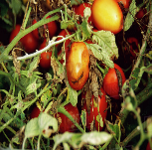
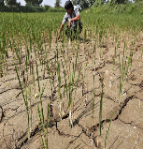
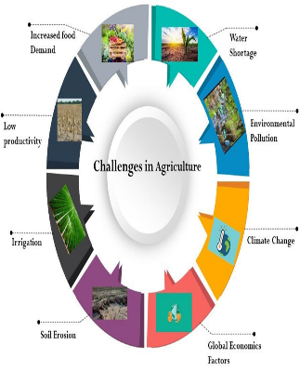
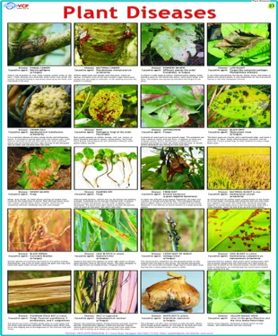
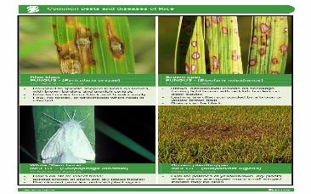
Challenges in Agriculture & Plant Diseases

Slide 7
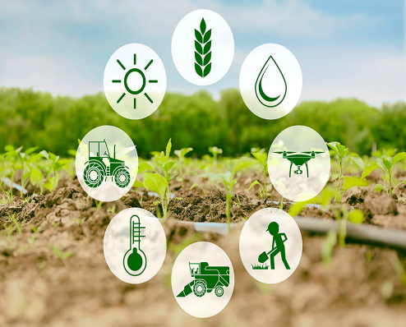
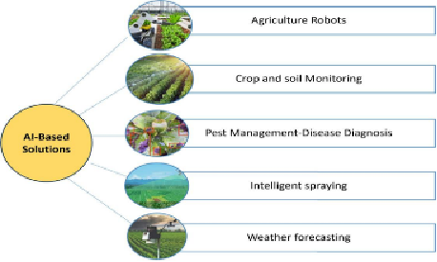
AI Based Solutions
AI-based solutions in agriculture encompass a wide range of applications that leverage artificial intelligence to improve efficiency, yield, and sustainability in farming practices. Some key AI applications in agriculture include:
Precision Agriculture
Crop Monitoring
Livestock Monitoring:
Market Forecasting
Soil Health Monitoring
Robotics and Automation

Slide 8
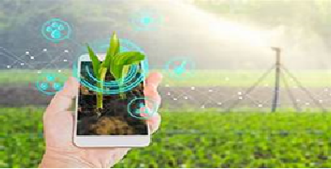
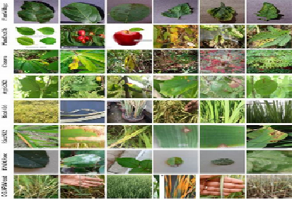
Advancement in plant Diseases detection
Advancements in plant disease detection have been driven by technological innovations, especially in the field of artificial intelligence and digital imaging. Some key advancements include:
AI and Machine Learning
Deep Learning in Identifying Plant Disease
Mobile Applications
Internet of Things(IoT)

Slide 9
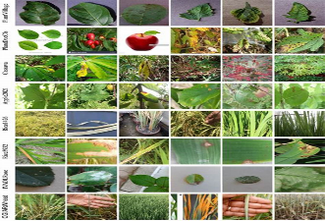
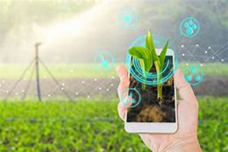
case study
PlantVillage: AI-Powered Crop Disease Management Platform
PlantVillage is an AI-powered platform designed to assist farmers in managing crop diseases effectively. The platform employs AI and crowdsourcing to identify and manage various crop diseases. With a vast database of images showcasing diseased crops, PlantVillage uses machine learning models to recognize diseases accurately.
Farmers can upload images of their crops, and the platform provides detailed information about the disease affecting their crops, along with recommended treatments. This approach enables early disease detection and helps farmers take timely actions to mitigate crop losses, ultimately enhancing agricultural productivity and sustainability.
Leaf Doctor: An AI-Powered Plant Disease Diagnosis Tool
Leaf Doctor is an innovative AI-powered tool developed by the University of California, Davis, for diagnosing plant diseases. The tool utilizes a deep learning algorithm to analyze images of plant leaves and accurately identify various diseases affecting crops. By leveraging the power of artificial intelligence, Leaf Doctor provides farmers and agricultural experts with a quick and reliable method for diagnosing plant diseases, enabling timely interventions to prevent crop losses.

Slide 10
Conclusion
In Conclusion,Generative AI is revolutionizing agricultural disease management by enhancing disease detection accuracy and reducing costs. Its ability to generate synthetic images for training models enables early intervention and improves crop health. As Generative AI continues to evolve, it holds promise for more sustainable and productive farming practices.

Slide 11
THANK YOU

